Slide 1
From Devops for data to DataOps
Niels Naglé & Vincent Goris
Notes:
Speaker: Niels

Slide 2

From DevOps for Data to DataOps
Niels Naglé & Vincent Goris
Info Support Nederland
Notes:
Speaker: Niels

Slide 3





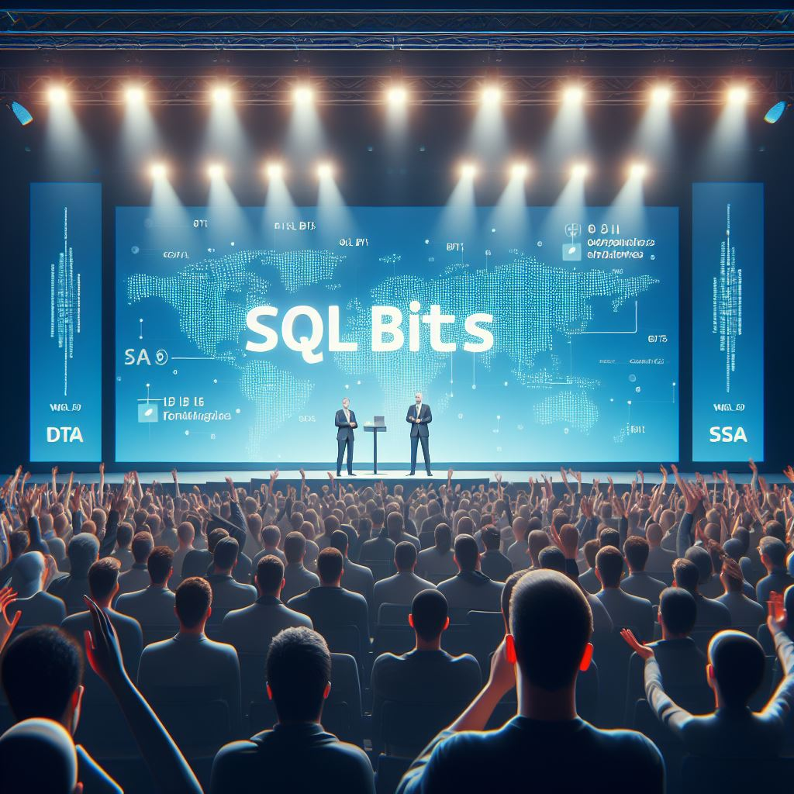


Notes:
Speaker: Niels

Slide 4

Your pilots
Vincent Goris Analyst, chapter lead Data & AI for healthcare unit vincent.goris@infosupport.com www.linkedin.com/in/vincent-goris
Notes:
Speaker: Vincent

Slide 5
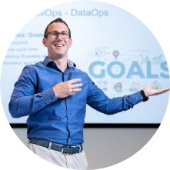
Your pilots
Niels Naglé Data Architect / Trainer / Speaker / Podcast host
Area lead Data & AI
Niels.Nagle@infosupport.com www.linkedin.com/in/nielsnagle
Notes:
Speaker: Niels

Slide 6

We
Data
Sharing Knowledge
Building Data savy organization
Brick by brick
Notes:
Speaker: Niels

Slide 7
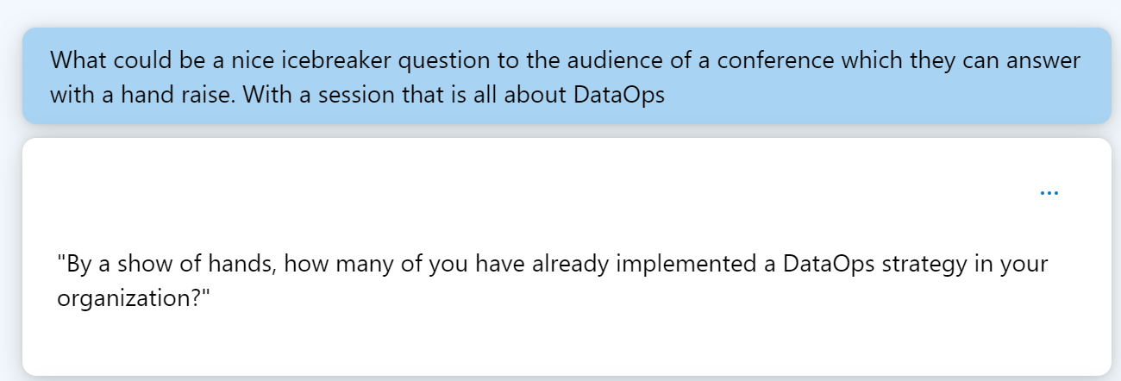
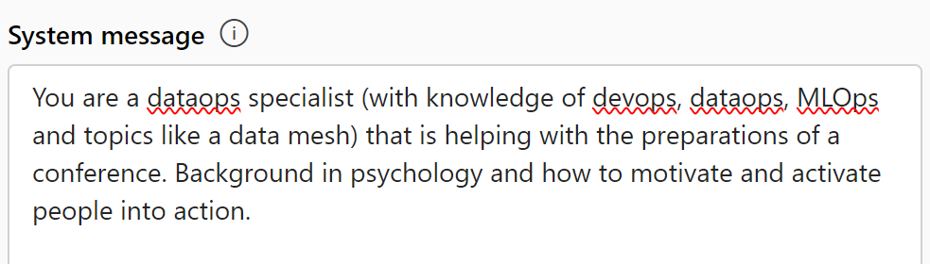
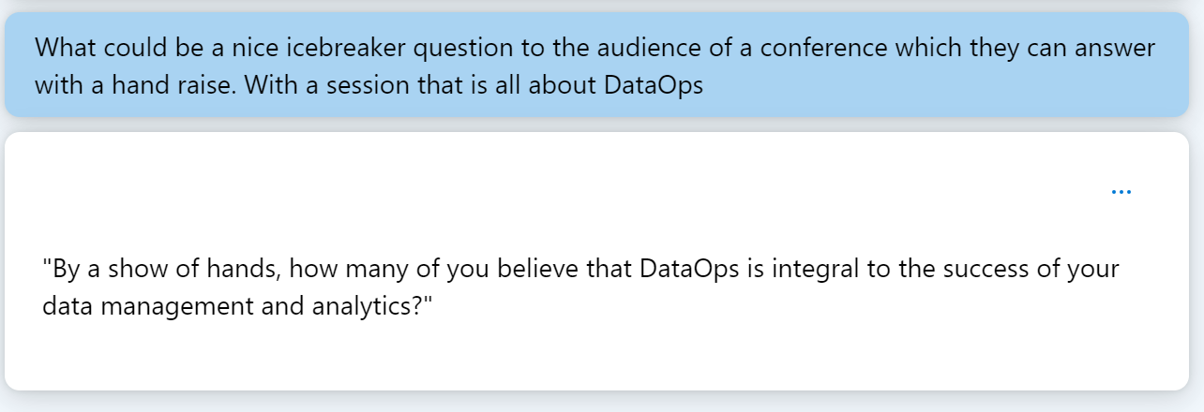
Notes:
How many of you have implemented devops for data?
How many of you are actively working on data governance?
How many of you are building advanced data testing and data quality monitoring?

Slide 8

Agenda
DevOps, Database DevOps and DataOps
DataOps Testing & Governance
Roadmap to DataOps
Wrap up & Questions

Slide 9
Agenda
DevOps, Database DevOps and DataOps
DataOps Testing & Governance
Roadmap to DataOps
Wrap up & Questions
Notes:
Speaker: Niels
Rough time per topic:
5 min Intro
8 min Devops, database DevOps and DataOps
12 min DataOps Testing & Governance
15 min Roadmap to DataOps – Culture + impact on organization and team
5 min Wrap up & questions

Slide 10
DevOps vs Database DevOps vs DataOps
Notes:
Speaker: Vincent

Slide 11
'DevOps is the ‘father’ of DataOps'
Peter Travkin
Notes:
Speaker: Vincent

Slide 12
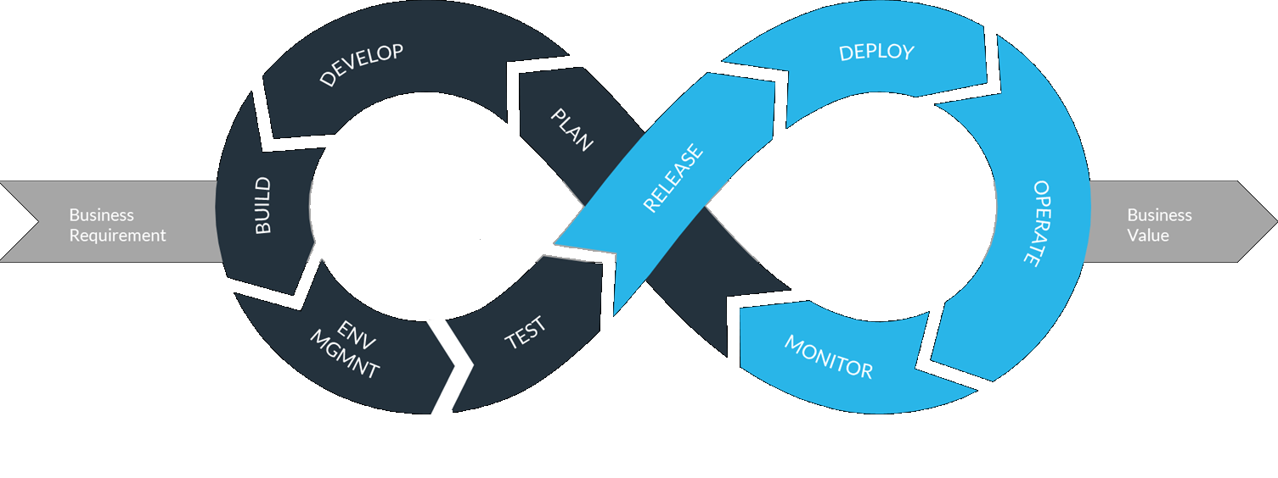
DevOps
Shared Responsibility
Automating, Monitoring and Testing
Shortened release cycle
Feedback cycle
More value for customer

Slide 13

DevOps in practice
Everything automated
Git
CI/CD
Multiple times a day
DTAP
Unittests/specflow
Notes:
Speaker: Vincent

Slide 14
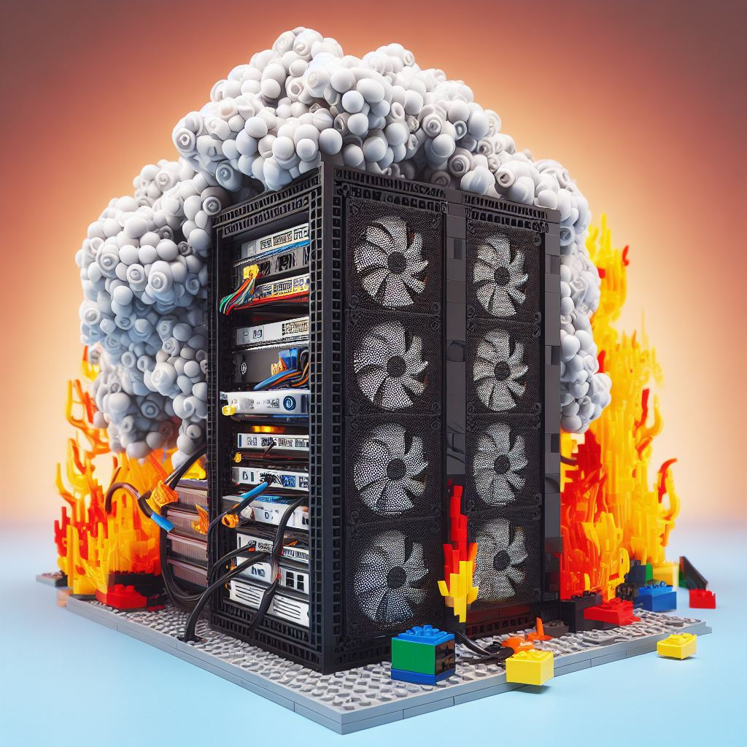
Data project issues
Changes in production
One time use solutions
Notes:
Speaker: Vincent

Slide 15

Data project issues
Versioning:
Database1
Database2
Database2.final
Database2.4
Database2.reallyfinal
Database2.final.final
Notes:
Speaker: Vincent

Slide 16
Database DevOps
(Azure) DevOps
Development of database through GIT
Version control
Automated deployment
Testing deployment
Make sure nothing breaks (unexpected)
Unit tests
Notes:
Speaker: Vincent
More and more metadata driven data developments

Slide 17
CI/CD
Versioning
Re-use
Tooling
Version your solutions AND the Data
Make sure components can be re-used
Different types of specialized tooling tuned to database DevOps
Notes:
Speaker: Vincent
More and more metadata driven data developments

Slide 18

What is DataOps?
Beyond Database DevOps
Notes:
Speaker: Vincent

Slide 19
Data Quality
Monitoring
Testing, testing and more testing
Culture
Governance
DataOps
Database DevOps

Slide 20

DataOps
DevOps
Goals
Working Agile
Reduce Cycle Time
Business Value
Automation
Testing
Reuse
Less Accidental complication
Notes:
Speaker: Vincent

Slide 21

DataOps
DevOps
Product
Mutating Object
Fluid Data
More Metrics
Data & Release Pipelines
Product
Static Product
Fluid Business
Fewer Metrics
Release Pipelines
Notes:
Speaker: Vincent

Slide 22
DataOps
DevOps
Culture
Essential
Organization Wide
Multidisciplinary
Data Governance
Culture
Optional
Single Team
Dev/Ops
Notes:
Speaker: Vincent

Slide 23

Agile
DevOps
Lean
DataOps
Fast Delivery (CI/CD)
Optimalization
Statistics
Monitoring
Culture
Notes:
Speaker: Vincent

Slide 24
Through Re-use & Governance
New features and additional data
Is an investment
Process Improvement
Through Testing
Bug Fixing
Notes:
Speaker: Vincent
Inspired by the DataKitchen in the dataops cookbook
Maturity is a Journey
Mention short term vs long term vision

Slide 25
Agenda
DevOps, Database DevOps and DataOps
DataOps Testing & Governance
Roadmap to DataOps
Wrap up & Questions
Notes:
Speaker: Niels

Slide 26
'Trust is nice, Testing is better !'
Vincent Goris
Notes:
Speaker: Niels

Slide 27

Data Quality and Testing
Data Fixated
Data Variable
Code Fixated
Value Pipeline
Code Variable
Innovation Pipeline
Quality = f(data, code)
Notes:
Speaker: Niels
Kleuren aanpassen zodat die overeenkomen

Slide 28
Data
Production
Value
Value Pipeline
Value Pipeline
Development
Idea
Innovation Pipeline
Notes:
Speaker: Niels
Innovation Pipeline
Database DevOps
Does it work?
Changes in code don’t break your solution
Value Pipeline
DataOps
Does it work with the data I receive?
The big bad world outside does not break your solution

Slide 29
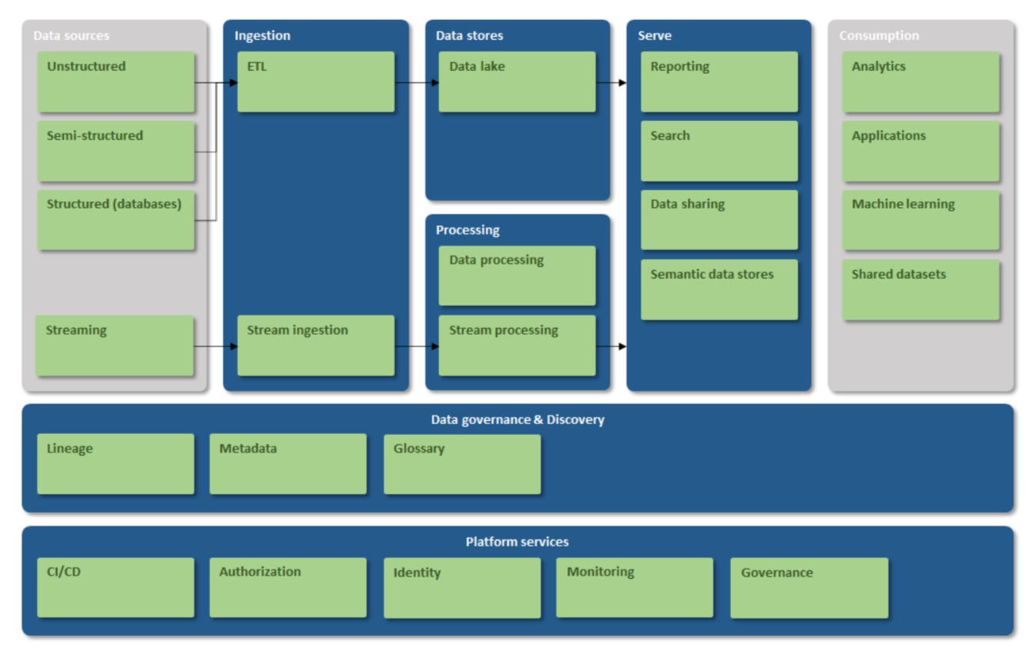

ELT / ETL
Notes:
Speaker: Niels

Slide 30
Ingestions Tests
Transformation Tests
Quality
Tests
ELT / ETL
Notes:
Speaker: Niels
For instance great expectations

Slide 31

Ingestion Tests
Frequency
Data contract / Data delivery agreement
Hard checks
Statistical distribution
Privacy and personal data
Error handling

Slide 32

Transformation Tests
Data Type
Unit Test
Transformation
# Columns
# Rows

Slide 33
Data Quality
Business Rules
Completeness
Data Drift
Metadata

Slide 34
Example
Date | Day | Icecream | Coffee | Total | Employee | Max temp celcius | Max temp Fahrenheit | Radiation (in J/cm2) / | Amount of rain (in 0.1 mm)
17-7-2018 | Tuesday | € 1.168,20 | -€ 169,20 | € 999,00 | 1 | 23 | 73 | 1616 | -1
18-7-2018 | Wednesday | € 1.746,10 | € 47,90 | € 1.794,00 | 2 | 29 | 84 | 2719 | 0
19-7-2018 | thursday | € 1.105,40 | € 29,90 | € 1.135,30 | 2 | 25 | 77 | 2332 | 0
20-7-2018 | Friday | € 256,60 | € 51,80 | € 308,40 | 1 | 23 | 73 | 796 | 85
21-7-2018 | Saturday | € 1.109,75 | € 39,60 | € 1.149,35 | 1 | 27 | 80 | 2625 | 0
22-7-2018 | Sunday | € 1.030,25 | € 25,50 | € 1.055,75 | 1 | 27 | 80 | 2310 | 0
7-23-2018 | Monday | € 1.059,75 |  | € 1.059,75 | 1 | 29 | 84 | 2646 | 0
24-7-2018 | Tuesday | € 1.128,95 | € 27,50 | € 1.156,45 | 1 | 32 | 89 | 2183 | 0
25-7-2018 | Wednesday | € 993,20 | € 36,50 | € 1.029,70 | 2 | 30 | 86 | 1623 | -1
26-7-2018 | Thursday | € 783,55 | € 46,00 | € 829,55 | 2 | 35 | 95 | 2497 | -1
27-7-2018 | Friday | € 1.050,15 | € 2.132,50 | € 1.082,65 | 1 | 35 | 95 | 2569 | 0
28-7-2018 | Saturday | € 812,75 | € 41,00 | € 853,75 | 2 | 24 | 75 | 1570 | 52
Data Drift
Business Rules
Completeness
Business Rules

Slide 35

Metadata, Catalog and Governance
Availability
Centrally registered data sources
Data lineage and (active) metadata
Automated testing
Responsibility
Usage insights
Notes:
Uitwerken Vincent

Slide 36
Roles and responsibilities
Chief data officer
Data owner
Data (flight) steward
Report owner
Report constructor
Data quality (air control)
Center of Excellence
Notes:
Andere achtegrond omdat we met name voor de agenda en de quotes switches. Anders oogt het nogal druk.
Inzicht in gebruikers van data producten ook hier data gedreven te werk gaan
Usage
Metrieken
Linieage

Slide 37

Roles and responsibilities
Notes:
Men and women sitting and standing while staring at laptop photo – Free Market survey Image on Unsplash
https://unsplash.com/photos/men-and-women-sitting-and-standing-while-staring-at-laptop-p74ndnYWRY4

Slide 38
'Building a factory is 100 times as hard as building a car'
Notes:
Speaker: Vincent

Slide 39
Agenda
DevOps, Database DevOps and DataOps
DataOps Testing & Governance
Roadmap to DataOps
Wrap up & Questions
Notes:
Speaker: Vincent

Slide 40
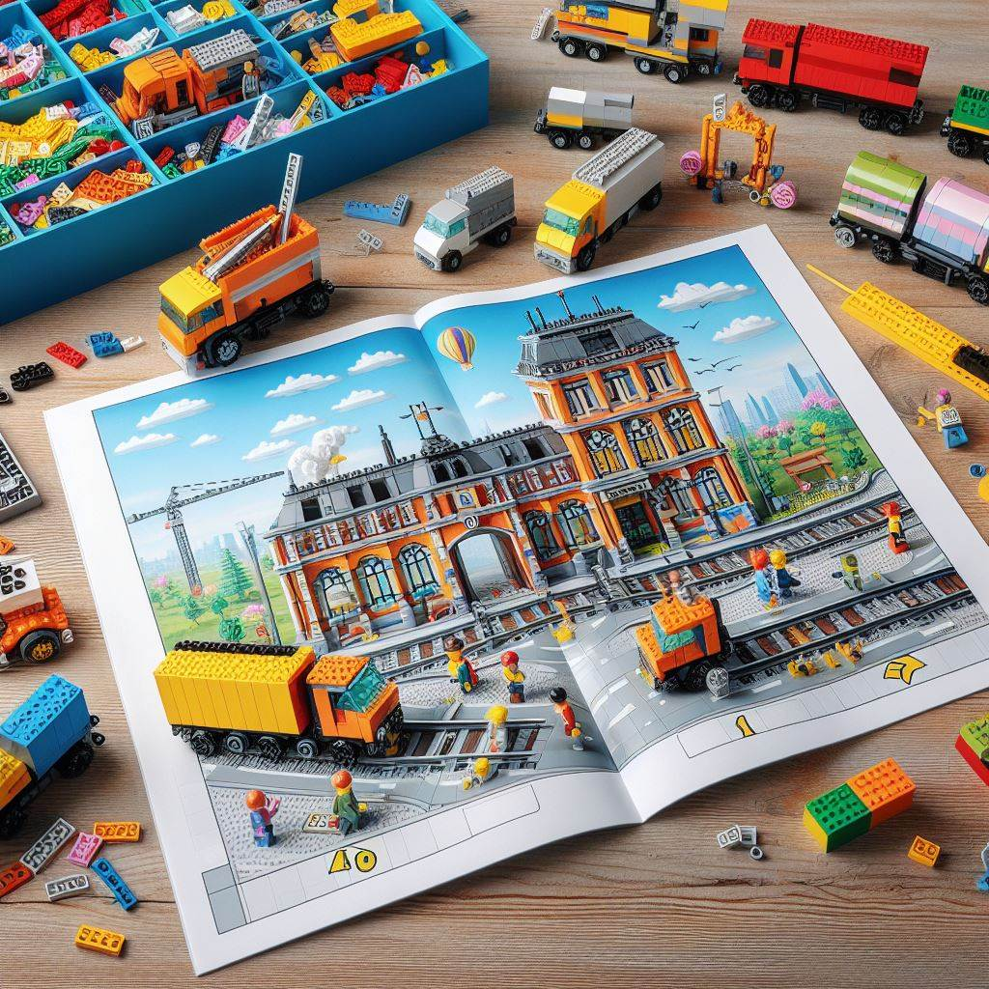
How to start

Slide 41











Roadmap to implement DataOps
1. Scan
2. Educate
3. Pilot
4. Productize
5. Grow
Data Driven Maturity
People, Process & Technology
Business Use-cases
Metadata, catalog
and governance
DataOps Maturity
Lean manufacturing
CI/CD
Automate & Smart
Showcase
Notes:
Speaker: Vincent

Slide 42


1. Scan
Gap analysis
Notes:
Speaker: Vincent
Understand the gap between your current state and your desired state.

Slide 43
Data-driven maturity model
Prescribe
Predict
Main source of competitive advantage
The way the business is done is defined
Innovative products and services can redefine the business model
Analytical transformation is a journey that never ends. The organization keeps progressing and keeps redefining itself in everything it does.
Continuous improvement is so deeply ingrained in the organization, it becomes second nature.
Stream & Operationalize
Focus on empowering everyone in the organization.
Allowing rapid integration of analytical features into products or services.
Everyone is warmed up for change during the previous stages.
Continually showing the success of an analytical approach.
Explore
Focus on developing and operationalizing prescriptive analytics .
Now what to do in the future to optimize our profitability
Operationalizing insight without manual actions
Recommendation services prescribe products to customers they will more likely respond to.
Collect & Store
Analytics is getting more formal and organized.
Insight shifts from the manager to the analytics department
Many of the prerequisites have been taken care of the next stage.
Management views predetermined reports and KPI ’s for more informed decisions.
Focus on orchestrating efforts to set up analytics .
Make data available for analyzing,
Basic reporting.
Analytics and a data-driven way of working must become official.
Notes:
Speaker: Vincent

Slide 44
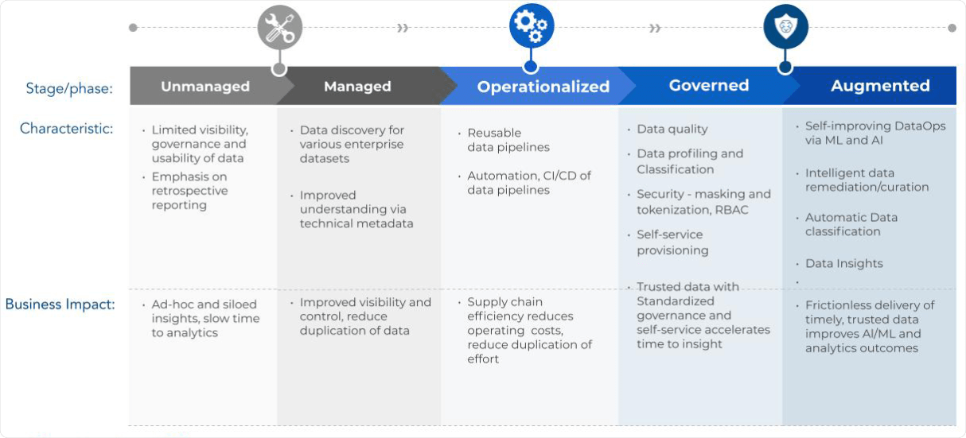
DataOps maturity
Unmanaged
Managed
Operationalized
Governed
Augmented
Source: Zaloni – DataOps maturity model

Slide 45
Roadmap to implement DataOps
1. Scan
2. Educate
3. Pilot
4. Productize
5. Grow
Data Driven Maturity
People, Process & Technology
Business Use-cases
Metadata, catalog
and governance
DataOps Maturity
Lean manufacturing
CI/CD
Automate & Smart
Showcase
Notes:
Speaker: Niels

Slide 46
2. Educate
People, Process & Technology
People
Process
Technology
Innovate
Scale
Automate
Notes:
Speaker: Niels
Visual van de golden triangle

Slide 47
2. Educate
Technologies and process (might be logical and straightforward)
Technology guidance
Continuous Integration / Continuous Deployment
Data Quality processes
Make people a priority, because it is a cultural change that needs to be lead
Roles and responsibilities
Demonstrate
Build trust
Build on this in small steps
Continuous delivery
Feedback loop
Communicate
Notes:
Speaker: Niels

Slide 48

Roles & Responsibilities
Demonstrate
Build Trust
CI/CD
Build on this in small steps
Testing
Culture
Business IT Management
Notes:
Speaker: Niels
Technologies and process (might be logical and straightforward)
Technology guidance
Continuous Integration / Continuous Deployment
Data Quality processes
Make people a priority, because it is a cultural change that needs to be lead
Roles and responsibilities
Demonstrate
Build trust
Build on this in small steps
Continuous delivery
Feedback loop
Communicate

Slide 49
Roadmap to implement DataOps
1. Scan
2. Educate
3. Pilot
4. Productize
5. Grow
Data Driven Maturity
People, Process & Technology
Business Use-cases
Metadata, catalog
and governance
DataOps Maturity
Lean manufacturing
CI/CD
Automate & Smart
Showcase
Notes:
Speaker: Vincent

Slide 50
Pilot: start small with high impact
Showcase
Data Quality
Get the whole organization involved, start with Governance
Start improving Data Quality
CI/CD
Testing
People
Start with basic CI/CD principles
First tests for Value and Innovation Pipelines
Culture is paramount
Notes:
Speaker: Vincent
Examples in use case
Git icm Azure DevOps
Simple branch and merge strategy feature/bugfix based in combination with release branches
Unfortunately, we lack multiple environments for developers this sometimes brings challenges but forces you to integrate on DEV environment
Modular built data & innovation pipelines

Slide 51
Roadmap to implement DataOps
1. Scan
2. Educate
3. Pilot
4. Productize
5. Grow
Data Driven Maturity
People, Process & Technology
Business Use-cases
Metadata, catalog
and governance
DataOps Maturity
Lean manufacturing
CI/CD
Automate & Smart
Showcase
Notes:
Speaker: Niels

Slide 52

4. Productize
Policies & procedures
Security & Privacy:
Infrastructure
Software
Data
Monitoring and support
Notes:
Speaker: Niels

Slide 53


4. Productize
Automate
Adaptable architecture in which data flows continuously, designers must automate everything
Profile and tag data
Map data to existing data sets (metadata injection)
Detect changes and identify the impact on downstream objects and applications
Detect anomalies and notify.
Notes:
Speaker: Niels

Slide 54

4. Productize
Smart
The ideal data architecture is more than just automated. it uses machine learning and artificial intelligence to learn, adjust, alert, and recommend.
Build data objects
Identifying data types, common keys and relations
Identify and help fix data quality errors
Recommend related data sets and analytics.
Notes:
Speaker: Niels
Link to purview and data scanning for example PII data

Slide 55
Roadmap to implement DataOps
1. Scan
2. Educate
3. Pilot
4. Productize
5. Grow
Data Driven Maturity
People, Process & Technology
Business Use-cases
Metadata, catalog
and governance
DataOps Maturity
Lean manufacturing
CI/CD
Automate & Smart
Showcase
Notes:
Speaker: Niels
Celebrate succes
Use storytelling
Data champions to tell the story

Slide 56
'Life’s a marathon, not a sprint'
Phillip C. McGraw
Notes:
Speaker: Niels

Slide 57
Challenges of DataOps
Notes:
Speaker: Niels

Slide 58
Challenges of DataOps
1
Cultural Shift
Culture shift
Resources / Roles in organization
Data Steward
Data owner
Etc.
Ownership / Governance
Test data
2
Technical Integration
3
Skillset and Training
Notes:
Speaker: Niels
Curtural shift: Implementing DataOps requires a cultural shift towards data collaboration, ownership, quality, governance and transparency.
Technical integration: Ensuring seamless integration of disparate data sources and technologies poses a challenge. Especially true for test data.
Skill set: Acquiring the necessary skills and providing relevant training for the implementation of data ops is crucial.

Slide 59
5 - Common Mistakes
Spend to little time on education (roles & responsibility)
Thinking Deployment is the Last Step
Focus only on the Technology/Tool
Stopping DataOps at the boarder of the central team
Only collecting the basic metrics and quality aspects
Notes:
Speaker: Niels
Weggelaten om er maar 5 te hebben Misalignment of the data team and business users

Slide 60
5 - Critical success factors
Acknowledge the cultural change (management Buy-in)
Communication, collaboration and governance
Invest in the platform and technology
Building Blocks for data product
Guardrails & safety checks for confidential data
Automate where possible
Embracing (gen)AI & machine learning as part of DataOps
Notes:
Speaker: Niels
Eruit gehaald om te blijven tot 5 :P
Iterate and gather feedback from different aspects and learn

Slide 61
'Dream big. Start small. But most of all, start! '
Simon Sinek
Notes:
Speaker: Niels

Slide 62
Agenda
DevOps, Database DevOps and DataOps
DataOps Testing & Governance
Roadmap to DataOps
Wrap up & Questions
Notes:
Speaker: Vincent

Slide 63
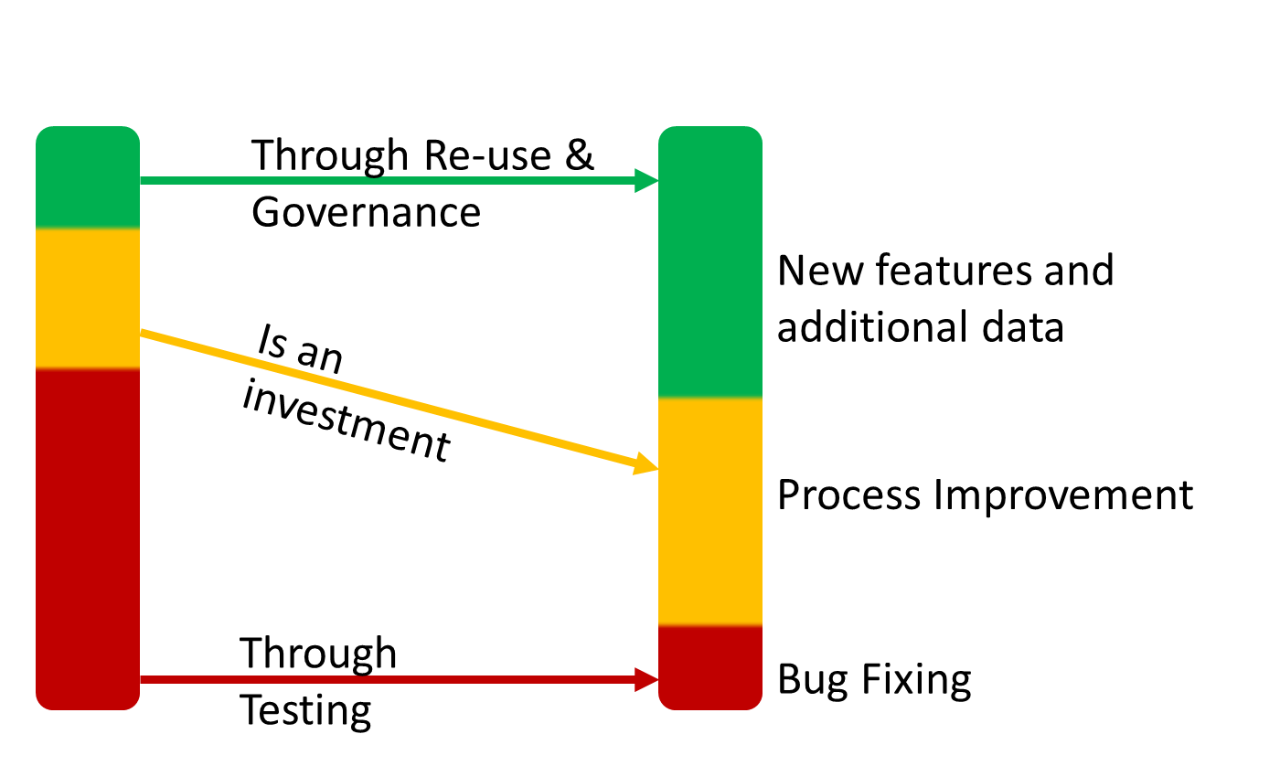
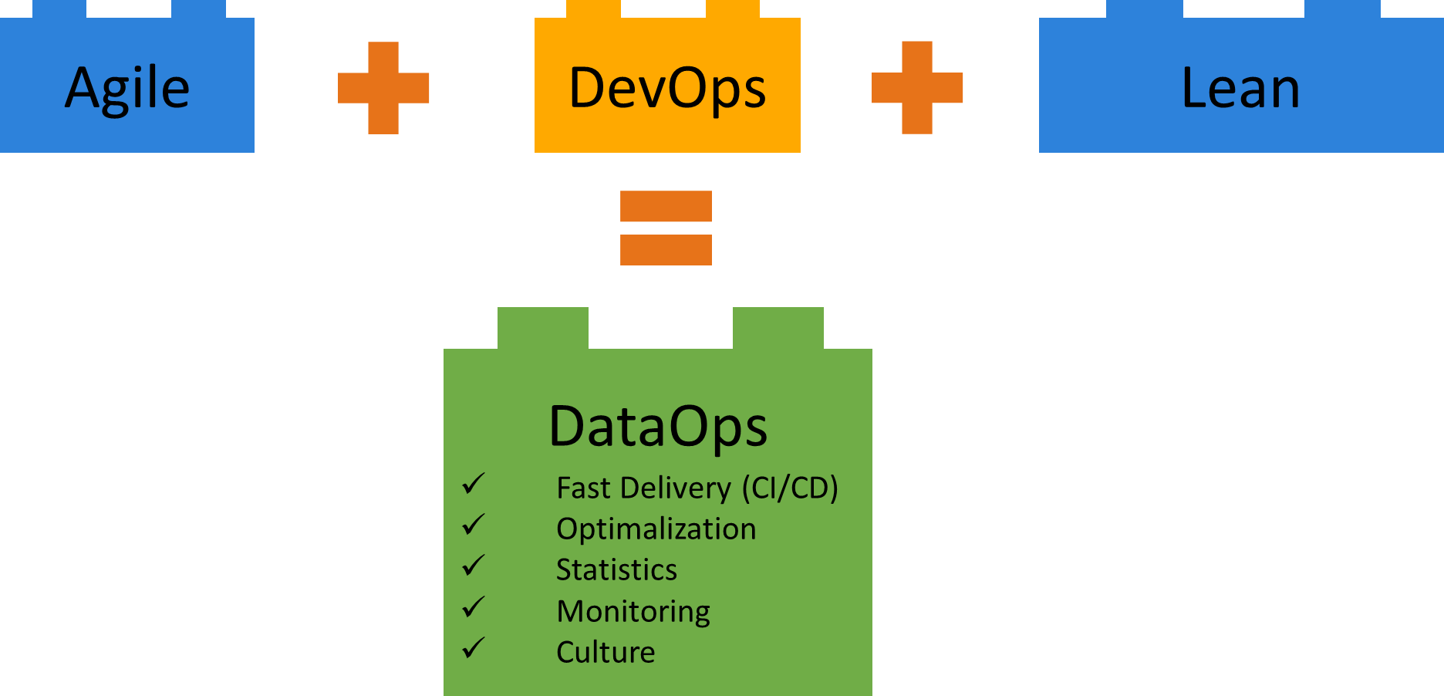
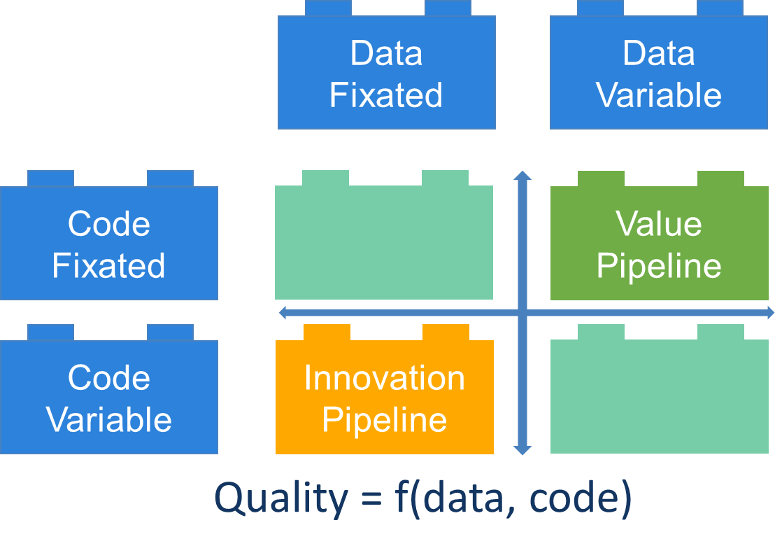
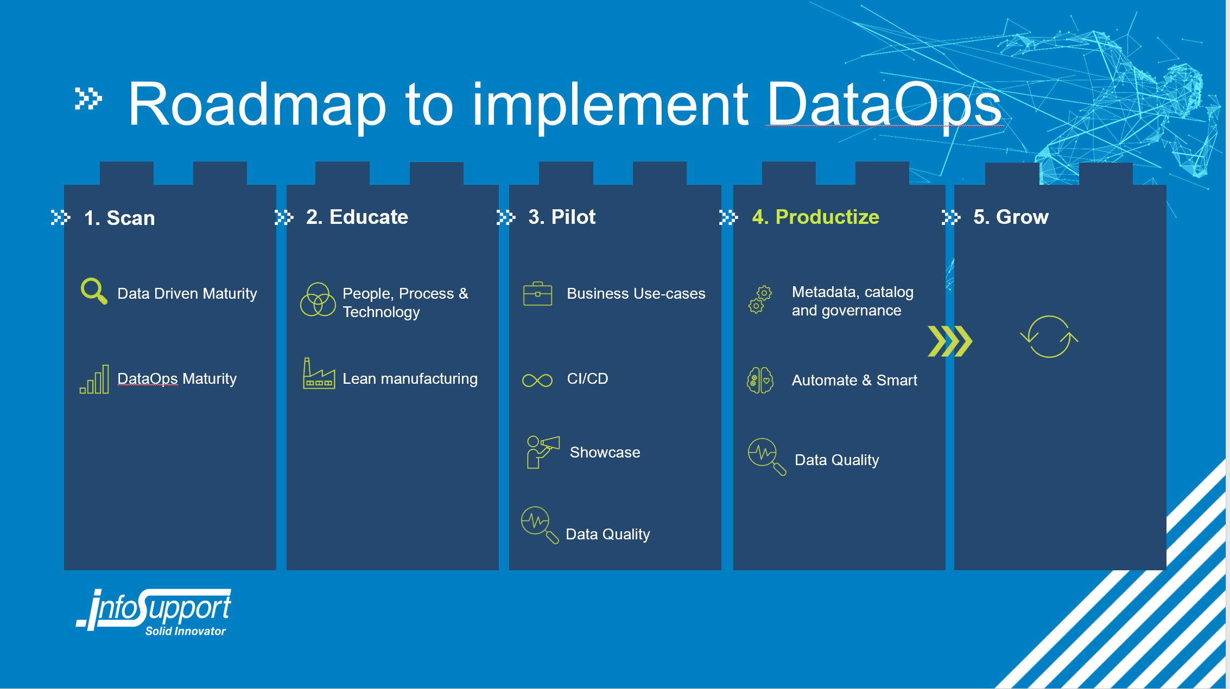
Wrap up
Notes:
Speaker: Vincent

Slide 64



Wrap up
Scalability & Agility
Operational Efficiency
Actionable Insights
DataOps provides agile methods and automation to enhance agility. Combined with a scalable framework to handle growing data volumes and complex data architectures.
It streamlines data operations, reducing manual efforts and improving resource utilization.
Enables the generation of high-quality actionable insights from diverse data sources for informed decision-making.

Slide 65


Questions ?
Congratulations you all passed the:
Pre Flight Check with us!
Have a safe DataOps flight and if you need help from air traffic control feel free to contact us!
Niels.Nagle@infosupport.com
www.linkedin.com/in/nielsnagle +31(0)645378501
Vincent.Goris@infosupport.com www.linkedin.com/in/vincent-goris
+31(0)653643536
Notes:
Speaker: Vincent

Slide 66
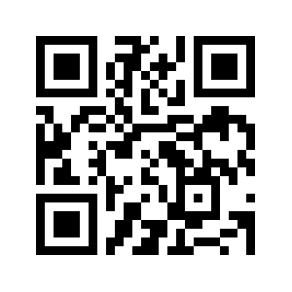

Feedback
Thank you for your feedback !!
Show the filled form and come grab a
“ Dutch Stroopwafel “
https://sqlb.it/?12632

Slide 67



Slide 68











